Slide 1

IST 687 Project TAJ Hotel Recommendation Project
Prajakta Mane - 867969039
Sayali Sant - 747787412
Ameya Mangaonkar - 601634662
This Photo by Unknown author is licensed under CC BY-SA.

Slide 2
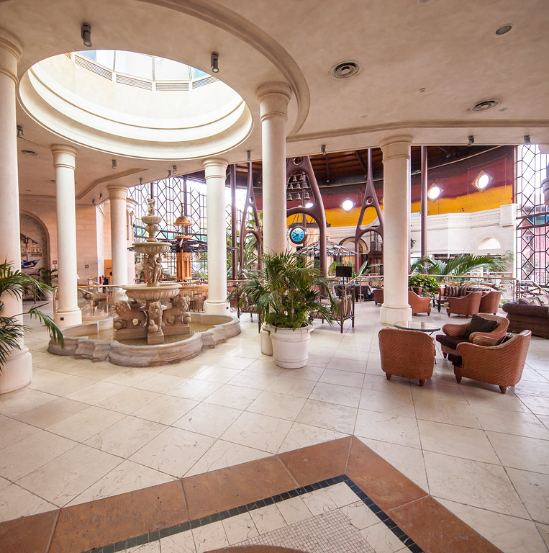
Taj has been recently purchased by a new owner and their current business strategy is not working.
Our objective is to increase the bookings in the hotel and decrease the cancelation rates.
We must predict why the hotel bookings are getting canceled and give out recommendations to avoid cancellations.
This Photo by Unknown author is licensed under CC BY.

Slide 3
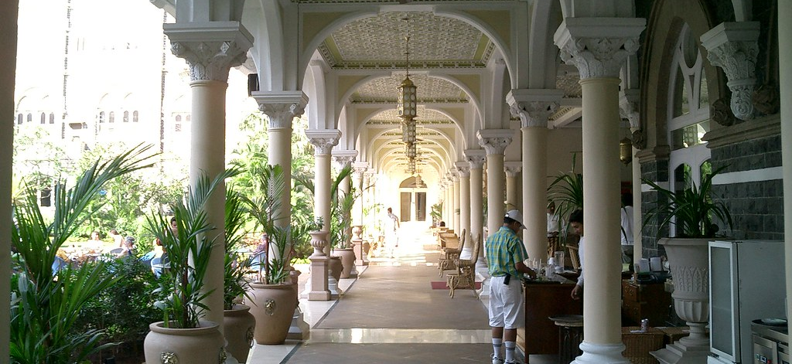
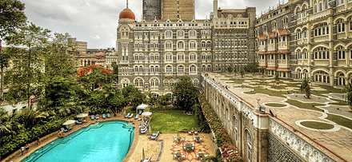
Problem Statement
Taj Hotels have faced a major problem of cancellations of their hotel bookings, and this has led to an economic downfall
We, as data analysts, have observed some reasons behind the hotel-booking cancellations using exploratory and statistical analysis and produce several recommendations which we feel would tackle the cancellations' problem
This Photo by Unknown author is licensed under CC BY-SA.
This Photo by Unknown author is licensed under CC BY-NC.

Slide 4
Initial Findings

Slide 5
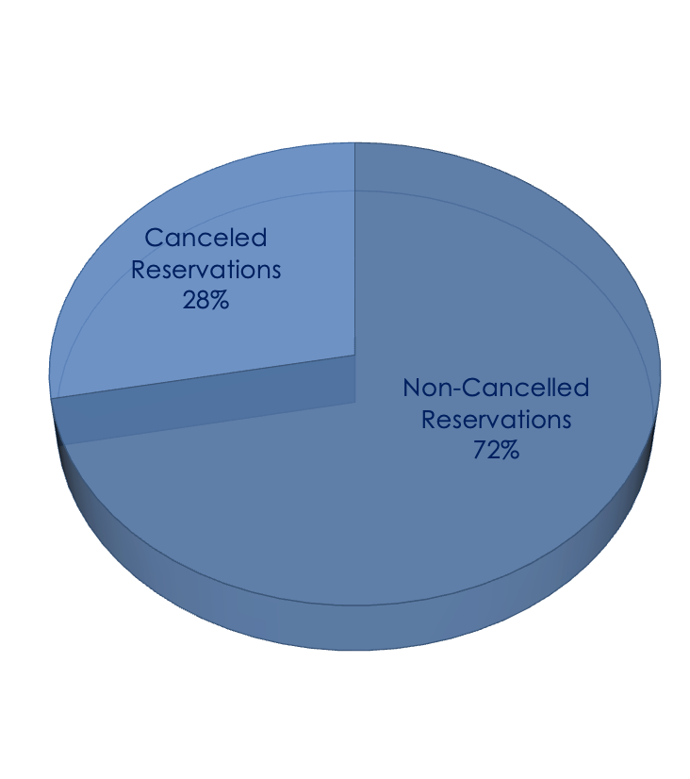
According to our initial findings, we discovered that the percentage of cancelled reservations was 28%
However, this data was not backed up by any factors as it was just an initial observation

Slide 6
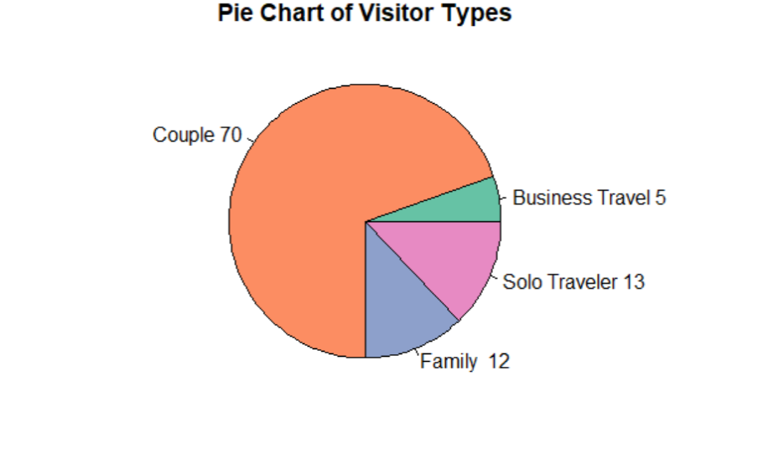
From the pie chart, we observe the distribution of the types of visitors visiting the hotel:
Couples constitute for over 70% of the bookings
Next is followed by Solo travelers which are around 13%, Families which are around 12% and lastly Business travelers which are around 5%

Slide 7

Analyzing the Reasons behind the Cancellations

Slide 8
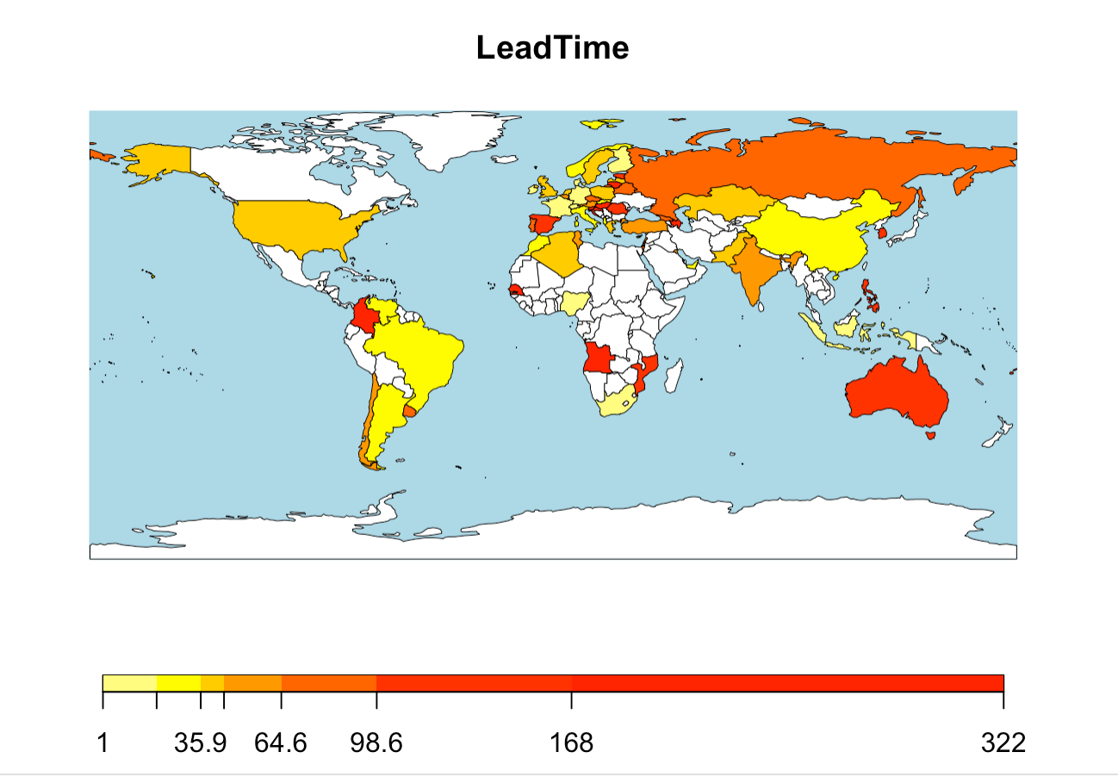
Lead Time Analysis
From the map, we have inferred that customer from countries like Australia, Columbia, etc. stay for the greatest number of days.
On the other hand, customers from countries like Indonesia, South Africa, etc. stay for the least number of days
From this, we recommend that we provide incentives to customers from Indonesia, South Africa, etc. So that they can increase their stay duration which in turn will generate revenue and increase the profits of our hotel

Slide 9
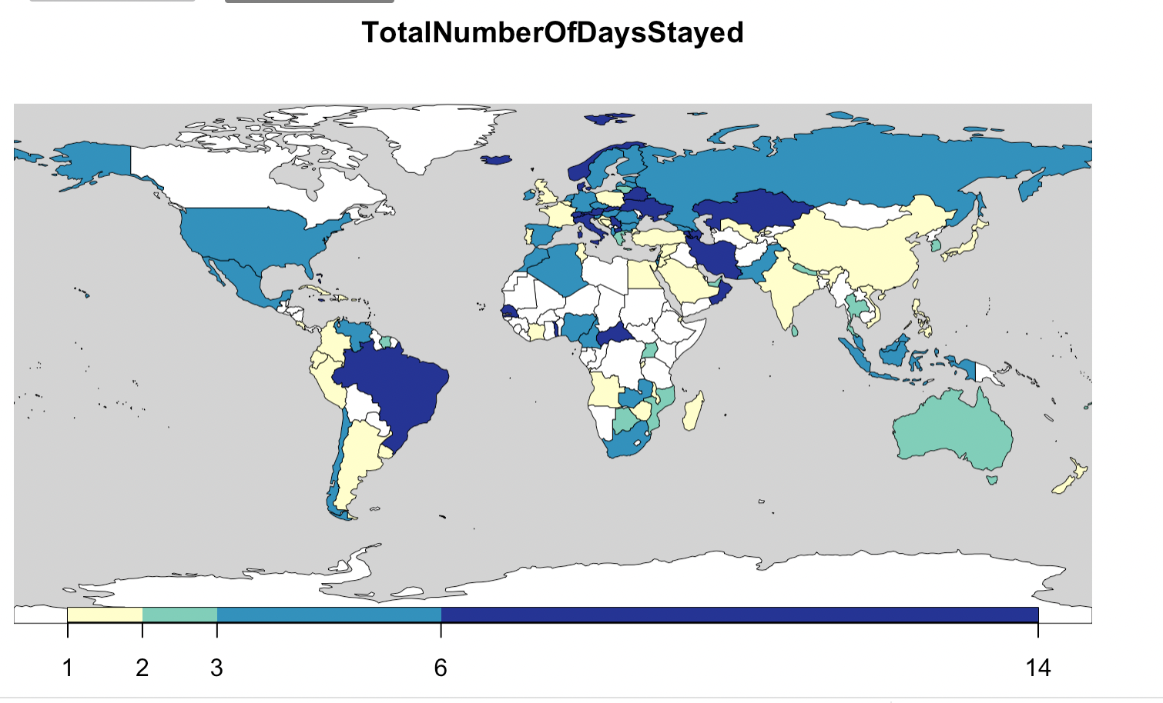
Duration of Stay Analysis
From the map, we have inferred that customer from countries like Brazil, Kazakhstan, etc. stay for the greatest number of days.
On the other hand, customers from countries like India, China, etc. stay for the least number of days
From this, we recommend that we provide incentives to customers from India, China, etc. So that they can increase their stay duration which in turn will generate revenue and increase the profits of our hotel

Slide 10
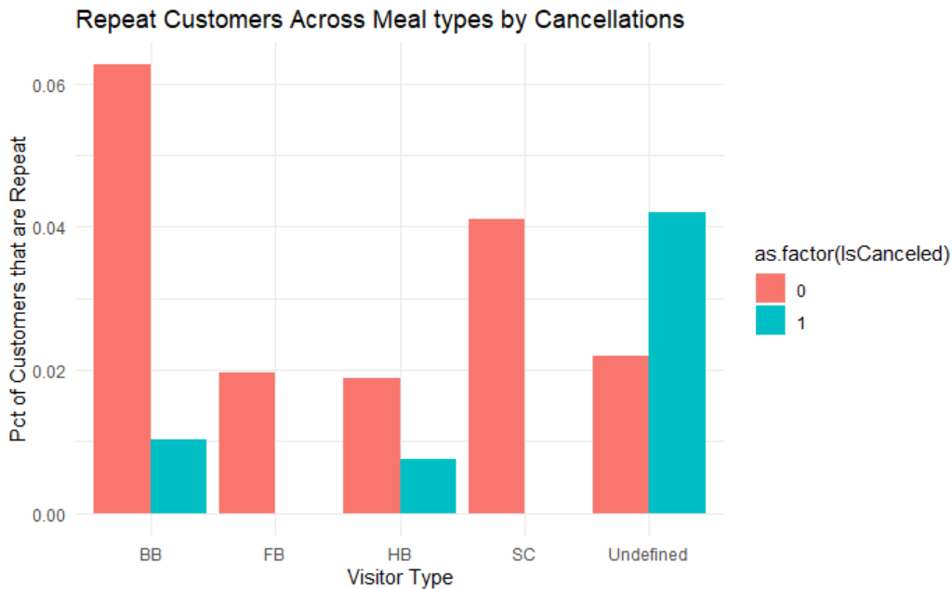
Meal type Analysis
6% of the people who have already visited the hotel choose their meal type as bed and breakfast and do not cancel the booking
When the meal type is undefined, 4% of the customers who visit the hotel before cancelling their booking.
If we want to increase the booking rate in the hotel, Bed & Breakfast should be provided

Slide 11
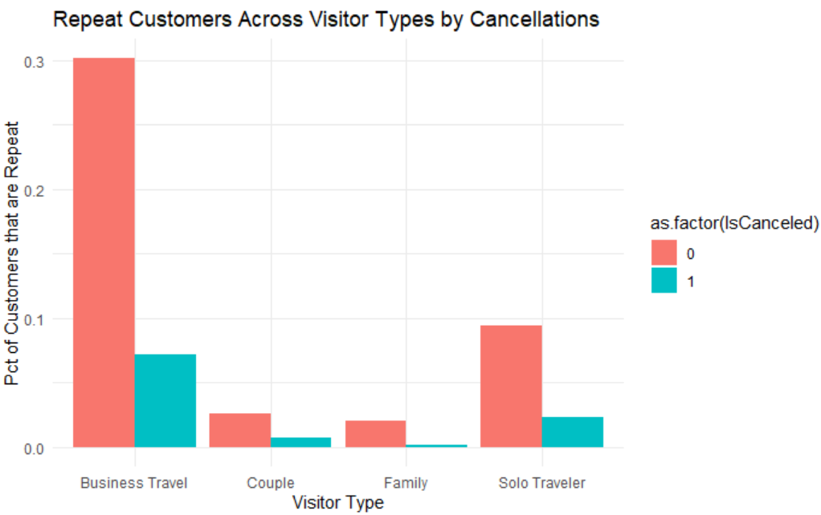
Repeated Customer Analysis
In Bar plot, we found out that 30% of the customers belonging to business travel repeat the hotel reservation and prefer to come back to that hotel.
Families and couples seem to not visit the hotel much after the first stay. We can provide families or couples with incentives or offers for the next stay so that they might end up booking our hotel the next time

Slide 12
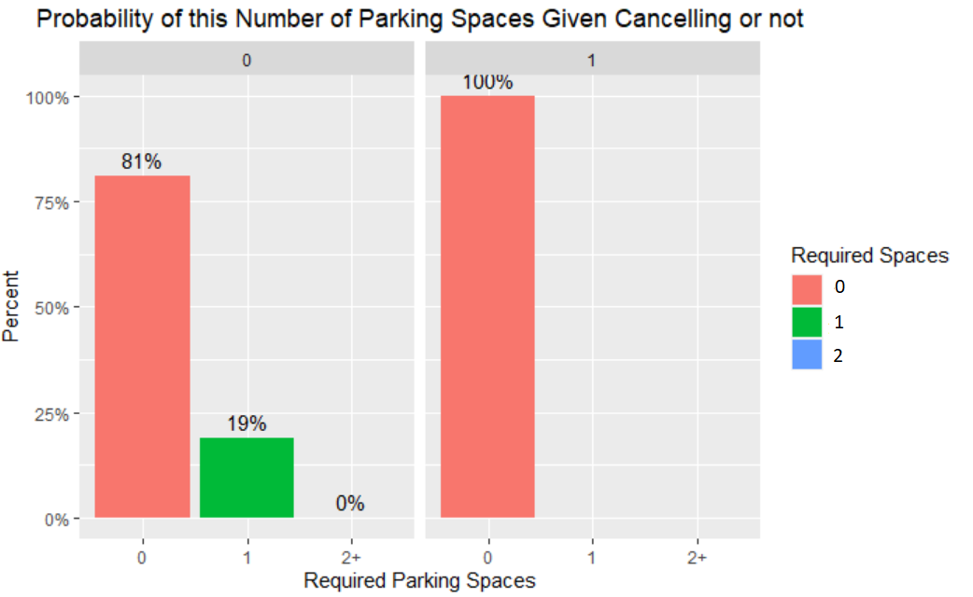
Parking Spaces Analysis
We have inferred that the 100% of customers tend to cancel their bookings when they are not provided with a parking space

Slide 13
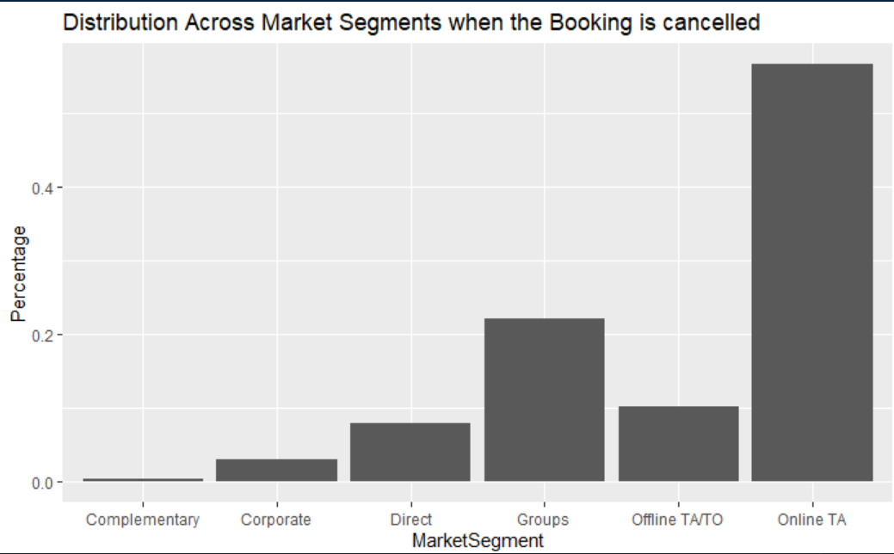
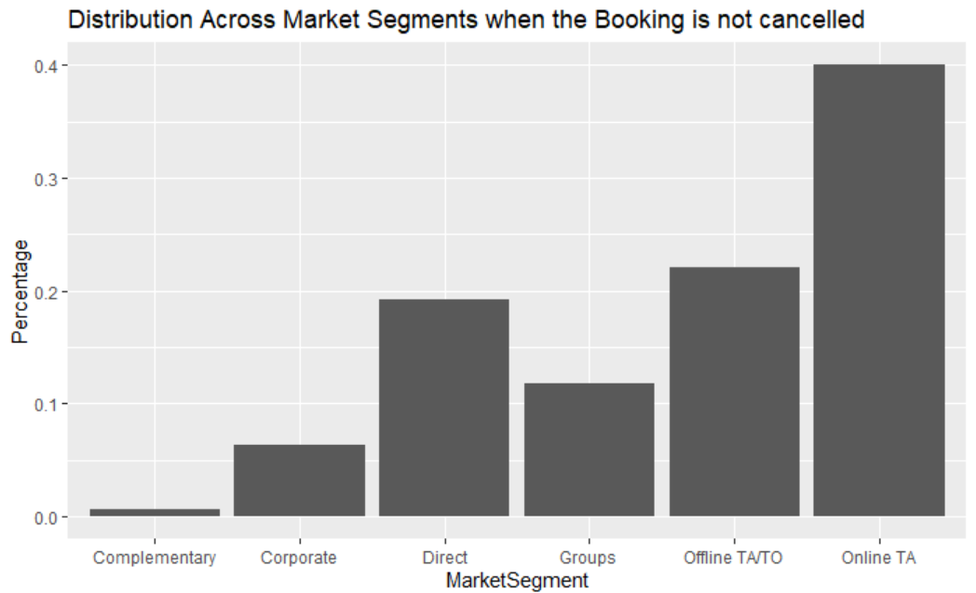
Market Segment Analysis
Among the bookings made via Online TA, 60% bookings gets cancelled
Most people end up cancelling their bookings when they book the hotel rooms in a group.
So, we recommend that, we should check with the Online TAs if there is any issue while booking.
Also, we can provide incentives to the groups while they are booking the hotel rooms

Slide 14
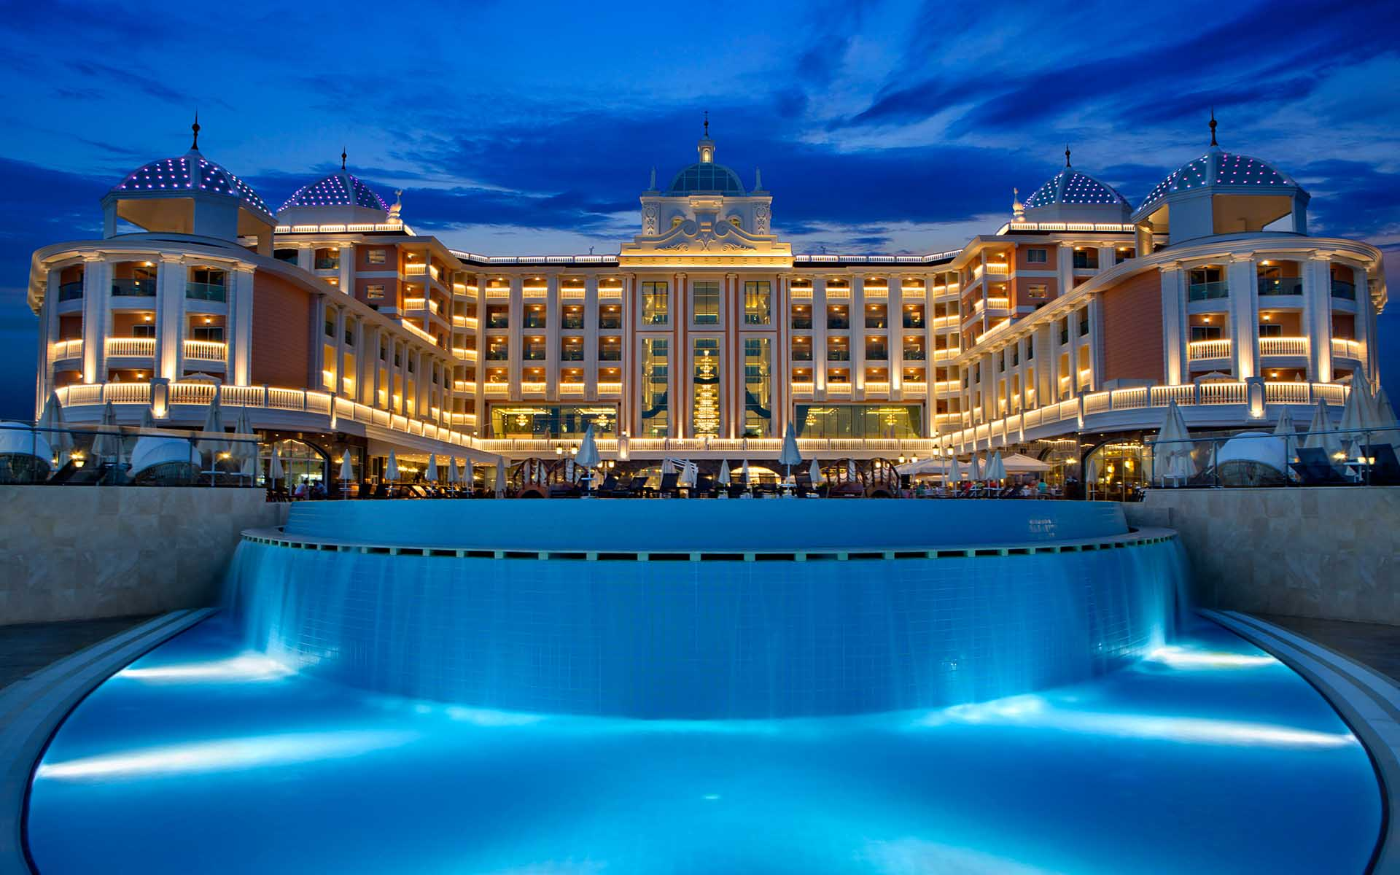
Recommendations
Our observations have suggested that customers cancel their bookings if they do not get room of their choice. Hence, we recommend that the hotel increases the availability of type A rooms so that more customers will be satisfied and in turn attract more customers.
We have also observed that customers are more likely to not cancel their bookings if they get a parking spot. Hence, the hotel should plan for more parking spaces and provide each customer with at least one parking space so that cancellations could be minimized
Customers are also likely to cancel their bookings if they haven’t made any previous deposits to confirm their bookings. Hence, we recommend that the hotels should encourage but not force the customers to pay some sort of deposit so that they feel compelled to stick to their bookings. If the customers are not willing to pay the deposit, then a fixed percentage of cancellation fee should be imposed on the customers.
This Photo by Unknown author is licensed under CC BY.

Slide 15
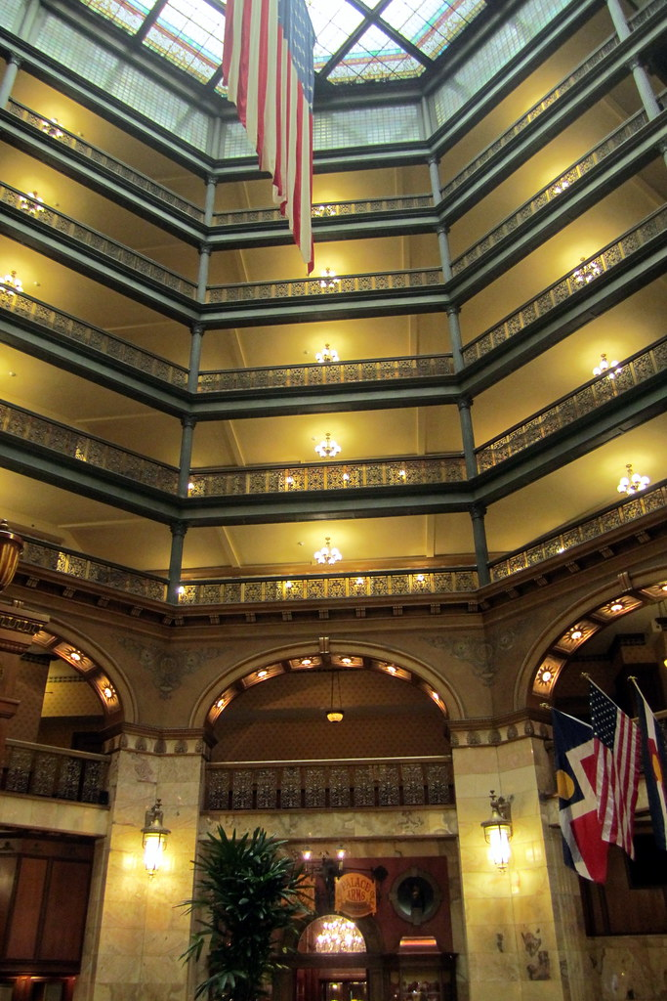
Conclusion
Hence to conclude we hope that the hotel follows our data-backed recommendations to make sure that the number of cancellations are reduced and they do not suffer economic setbacks
While our data analysis provided sufficient insights, we also recommend the hotel to conduct more research for more accurate results and conclusions
This Photo by Unknown author is licensed under CC BY-NC-ND.

